Slide 1

Project Procurement Management

Slide 2
What is project procurement management?
It is part of project management that includes the processes required to acquire goods and services to attain project scope from outside the performing organization.

Slide 3
Importance of project procurement management
Procurement means acquiring goods and/or services from an outside source
Other terms include purchasing and outsourcing
Experts predicted that by the year 2003 the worldwide information technology outsourcing market would grow to over $110 billion
India is the leading country for U.S. offshore outsourcing.

Slide 4
Why outsource?
To reduce both fixed and recurrent costs
To allow the client organization to focus on its core business
To access skills and technologies
To provide flexibility
To increase accountability

Slide 5
Project procurement management processes
Processes include:
  Procurement Planning: Determining what to procure, when, and how.
  Solicitation Planning: Describing requirements for the products or services desired from the procurement and identifying potential sources or sellers (contractors, suppliers, or providers who provide goods and services to other organizations).
  Solicitation: Obtaining information, quotes, bids, offers, or proposals from sellers, as appropriate.

Slide 6
…processes continued
  Source Selection: Choosing from among potential suppliers through a process of evaluating potential sellers and negotiating the contract.
  Contract Administration: Managing the relationship with the selected seller.
  Contract Closeout: Completing and settling each contract, including resolving any open items.

Slide 7
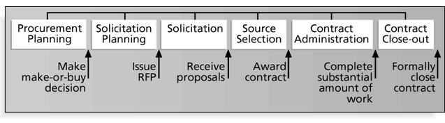
PROJECT PROCUREMENT MANAGEMENT PROCESSES AND KEY OUTPUTS

Slide 8
Procurement Planning
Identifying which project needs can best be met by using products or services outside the organization.
If there is no need to buy any products or services from outside the organization, then there is no need to perform any of the other procurement management processes.

Slide 9
Procurement Planning
Procurement planning involves identifying which project needs can be best met by using products or services outside the organization. It includes deciding
  Whether to procure
  How to procure
  What to procure
  How much to procure
  When to procure

Slide 10
Procurement planning tools and techniques
Make-or-buy analysis: determining whether a particular product or service should be made or performed inside the organization or purchased from someone else. Often involves financial analysis
Experts, both internal and external, can provide valuable inputs in procurement decisions

Slide 11
Make-or buy example
Assume you can lease an item you need for a project for $800/day. To purchase the item, the cost is $12,000 plus a daily operational cost of $400/day.
How long will it take for the purchase cost to be the same as the lease cost?

Slide 12
Make-or buy solution
Set up an equation so both options, purchase and lease, are equal.
In this example, use the following equation. Let d be the number of days to use the item:
  $12,000 + $400d = $800d
  Subtracting $400d from both sides, you get:
  $12,000 = $400d
  Dividing both sides by $400, you get:
  d = 30
If you need the item for more than 30 days, it is more economical to purchase it.

Slide 13
Contracts
A contract is a mutually binding agreement that obligates the seller to provide the specified products or services and obligates the buyer to pay for them.
Contracts can clarify responsibilities and sharpen focus on key deliverables of a project.
Because contracts are legally binding, there is more accountability for delivering the work as stated in the contract.
A recent trend in outsourcing is the increasing size of contracts.

Slide 14
Types of contracts
Fixed-price or lump-sum: involve a fixed total price for a well-defined product or service
Cost-reimbursable: involve payment to the seller for direct and indirect costs
Time and material contracts: hybrid of both fixed-price and cost-reimbursable, often used by consultants
Unit price contracts: require the buyer to pay the seller a predetermined amount per unit of service

Slide 15
Cost reimbursable contracts
Cost plus incentive fee (CPIF): the buyer pays the seller for allowable performance costs plus a predetermined fee and an incentive bonus
Cost plus fixed fee (CPFF): the buyer pays the seller for allowable performance costs plus a fixed fee payment usually based on a percentage of estimated costs
Cost plus percentage of costs (CPPC): the buyer pays the seller for allowable performance costs plus a predetermined percentage based on total costs

Slide 16
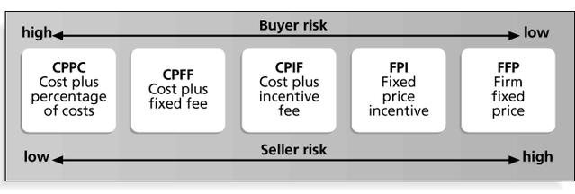
Contract types versus risk

Slide 17
Procurement management plan
Describes how the procurement processes will be managed, from developing documentation for making outside purchases or acquisitions to contract closure.
Contents vary based on project needs.

Slide 18
Statement of Work (SOW)
A statement of work is a description of the work required for the procurement.
If a SOW is used as part of a contract to describe only the work required for that particular contract, it is called a contract statement of work.
A SOW is a type of scope statement.
A good SOW gives bidders a better understanding of the buyer’s expectations.

Slide 19
Statement of Work (SOW) Template
I.
Scope of Work:
Describe the work to be done to detail. Specify the hardware and
software involved and the exact nature of the work.
II.
Location of Work:
Describe where the work must be performed. Specify the
location of hardware and software and where the people must perform the work
III.
Period of Performance:
Specify when the work is expected to start and end,
working hours, number of hours that can be billed per week, where the work must
be performed, and related schedule information.
IV.
Deliverables Schedule:
List specific deliverables, describe them in detail, and
specify when they are due.
V.
Applicable Standards:
Specify any company or industry-specific standards that
are relevant to performing the work.
VI.
Acceptance Criteria:
Describe how the buyer organization will determine if the
work is acceptable.
VII.
Special Requirements:
Specify any special requirements such as hardware or
software certifications, minimum degree or experience level of personnel, travel
requirements, and so on.

Slide 20
Plan contracting
Involves preparing several documents needed for potential sellers to prepare their responses and determining the evaluation criteria for the contract award.
  Request for Proposals (RFP): Used to solicit proposals from prospective sellers.
    A proposal is a document prepared by a seller when there are different approaches for meeting buyer needs.
  Requests for Quotes (RFQ): Used to solicit quotes or bids from prospective suppliers.
    A bid, also called a tender or quote (short for quotation), is a document prepared by sellers providing pricing for standard items that have been clearly defined by the buyer.

Slide 21
Outline for a Request for Proposal (RFP)
I.
Purpose of RFP
II.
Organization’s Background
III.
Basic Requirements
IV.
Hardware and Software Environment
V.
Description of RFP Process
VI.
Statement of Work and Schedule Information
VII.
Possible Appendices
A.
Current System Overview
B.
System Requirements
C.
Volume and Size Data
D.
Required Contents of Vendor’s Response to RFP
E. Sample Contract

Slide 22
Evaluation criteria
It’s important to prepare some form of evaluation criteria, preferably before issuing a formal RFP or RFQ.
Beware of proposals that look good on paper; be sure to evaluate factors, such as past performance and management approach.
Can require a technical presentation as part of a proposal.

Slide 23
Requesting seller responses
Deciding whom to ask to do the work, sending appropriate documentation to potential sellers, and obtaining proposals or bids.
Organizations can advertise to procure goods and services in several ways:
  Approaching the preferred vendor.
  Approaching several potential vendors.
  Advertising to anyone interested.
A bidders’ conference can help clarify the buyer’s expectations.

Slide 24
Selecting sellers
Also called source selection.
Involves:
  Evaluating proposals or bids from sellers.
  Choosing the best one.
  Negotiating the contract.
  Awarding the contract.

Slide 25
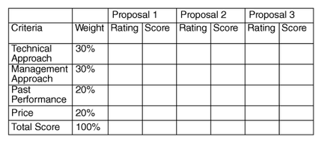
Sample proposal evaluation sheet

Slide 26
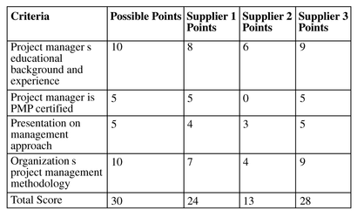
Detailed criteria for selecting suppliers

Slide 27
Be careful in selecting suppliers and writing their contracts
Many dot-com companies were created to meet potential market needs, but many went out of business, mainly due to poor business planning, lack of senior management operations experience, lack of leadership, and lack of visions.
Check the stability of suppliers
Even well-known suppliers can impede project success. Be sure to write and manage contracts well with all suppliers.

Slide 28
Seller selection process
Organizations often do an initial evaluation of all proposals and bids and then develop a short list of potential sellers for further evaluation.
Sellers on the short list often prepare a best and final offer
Final output is a contract signed by the buyer and the selected seller.

Slide 29
Administering the contract
Contract administration ensures that the seller’s performance meets contractual requirements
Contracts are legal relationships, so it is important that legal and contracting professionals be involved in writing and administering contracts
Many project managers ignore contractual issues, which can result in serious problems

Slide 30
Suggestions on change control for contracts
Changes to any part of the project need to be reviewed, approved, and documented by the same people in the same way that the original part of the plan was approved
Evaluation of any change should include an impact analysis. How will the change affect the scope, time, cost, and quality of the goods or services being provided?
Changes must be documented in writing. Project team members should also document all important meetings and telephone calls

Slide 31
Suggestions on change control for contracts (cont...)
Project managers and teams should stay closely involved to make sure the new system will meet business needs and work in an operational environment.
Have backup plans.
Use tools and techniques, such as a contract change control system, buyer-conducted performance reviews, inspections and audits, and so on.

Slide 32
Closing the contract
Involves completing and settling contracts and resolving any open items.
The project team should:
  Determine if all work was completed correctly and satisfactorily.
  Update records to reflect final results.
  Archive information for future use.
The contract itself should include requirements for formal acceptance and closure.

Slide 33
Using software to assist in project procurement management
Word processing software helps in writing proposals and contracts, spreadsheets help in evaluating suppliers, databases help track suppliers, and presentation software aids in presenting procurement-related information
E-procurement software does many procurement functions electronically.
Organizations also use other Internet tools to help find information on suppliers or auction goods and services

Slide 34
Reading Assignment
Describe the five project management process groups (IPECC).
        Initiation
        Planning
        Execution
        Controlling
        Closing

Slide 35



